Slide 1

Phishing Attacks
by- Ashish Chaudhary

Slide 2
Introduction
WHAT IS PHISING ?
A cyber-attack that tricks people into giving away sensitive information like passwords, credit card details, or personal data.
Disguised as a trusted email, website, or message. Real-World Fact: Phishing was responsible for 36% of all data breaches in 2024 (Verizon DBIR).
Phishing attacks are deceitful practices used to steal sensitive information. Understanding how to recognize these attacks, their methods, and implementing preventative measures are crucial. This presentation covers how to identify phishing emails and fake websites, explore social engineering tactics, and provides effective strategies to avoid becoming a victim.

Slide 3

01
Recognizing Phishing

Slide 4

Signs of phishing emails
Generic greetings (“Dear Customer” instead of your name).
Urgent language (“Act Now or Your Account Will Be Closed”).
Unexpected attachments or links.
Be vigilant for unusual sender addresses, poor grammar, urgent language, and unexpected attachments. Mistrust emails asking for personal information or prompting action via links.

Slide 5
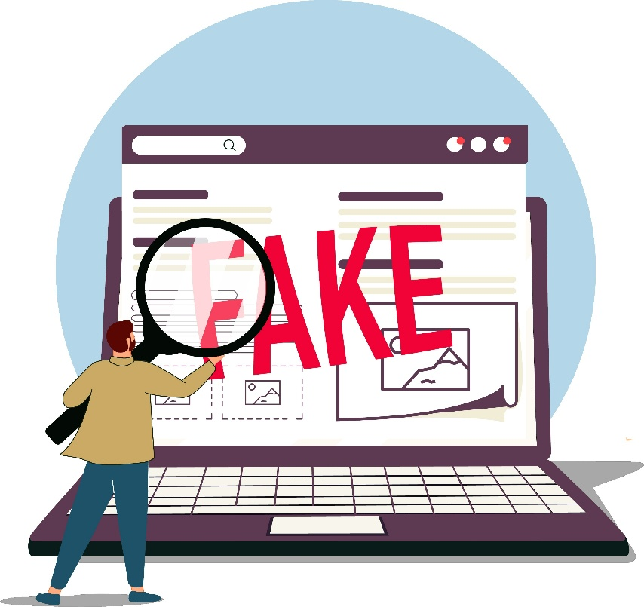
Identifying fake websites
Clues to Detect Fake Sites
Look for HTTPS: No padlock? Be cautious.
Check the URL carefully: phishing-site.com/login instead of legitimate-site.com.
Design flaws: Low-quality logos, mismatched fonts, broken links.
Pop-ups asking for sensitive info.

Slide 6
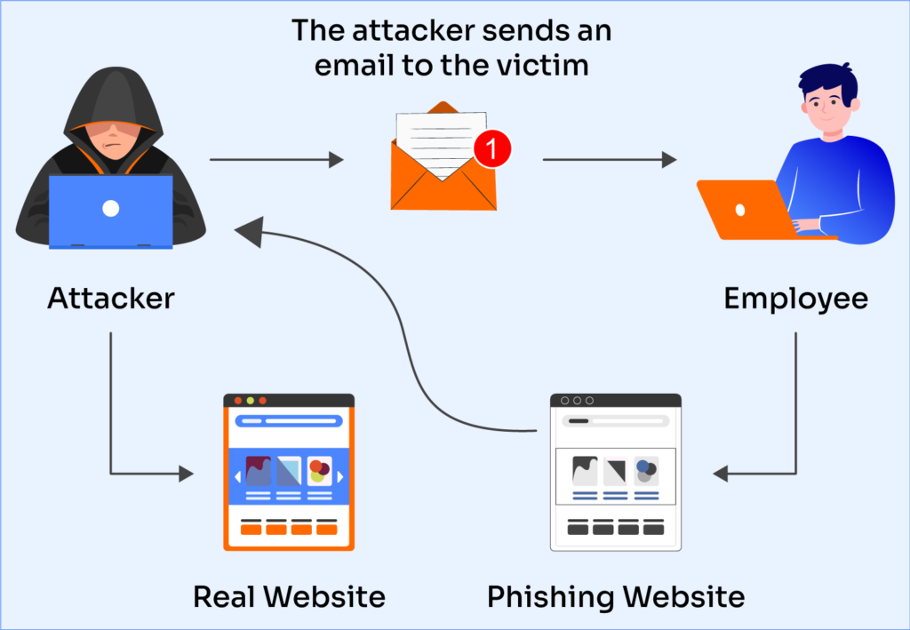
Common phishing techniques
How Attackers Trick You
Pretexting: Pretend to be someone you trust (boss, bank, government).
Baiting: Free offers or prizes to lure you.
Tailgating: Following you into secure areas.
Scare Tactics: Threatening account suspension or legal action.
Real Example: CEO Fraud where attackers impersonate a company head to request wire transfers.

Slide 7

02
Social Engineering Tactics

Slide 8
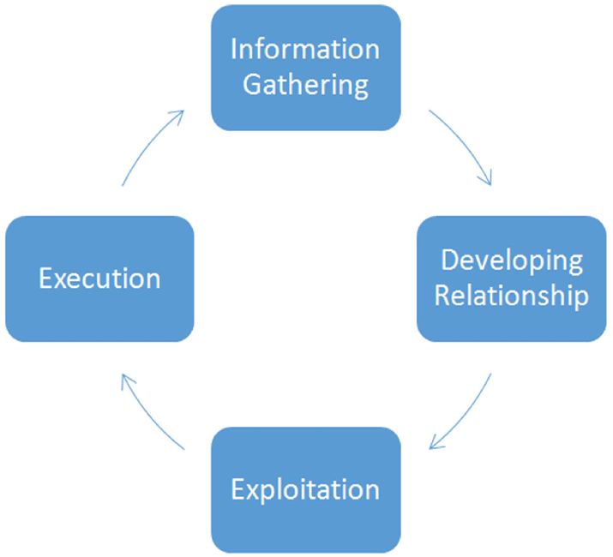
Understanding social engineering
Social engineering involves manipulating people into divulging confidential information.
Attackers exploit psychological tactics, leveraging trust and urgency to deceive individuals.
Being aware of these tactics is essential for personal and organizational security.

Slide 9
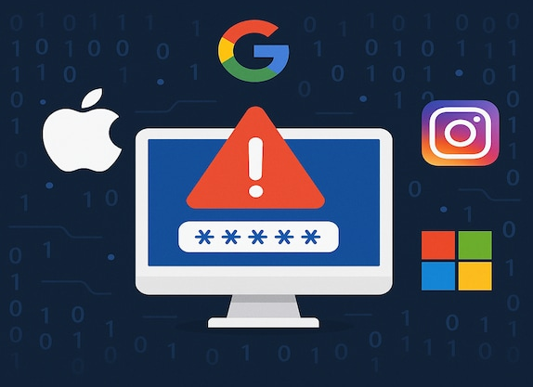
Real-World Examples
Famous Phishing Incidents
Google & Facebook (2013-2015): $100M lost to a fake vendor scam.
Sony Pictures (2014): Employees tricked into sharing credentials.
Target (2013): Breach via a third-party vendor phishing attack.
Lesson: Even big companies can be victims.

Slide 10

Case studies of social engineering attacks
Notable examples include the Target data breach where attackers used stolen credentials via phishing, and the Twitter hack where social engineering tricks led to high-profile account compromises. These incidents highlight the dangers of social engineering and its real-world implications.

Slide 11

03
Best Practices

Slide 12

Email safety tips
Always verify the sender's email address,
Avoid clicking unknown links, and refrain from sharing personal information over email.
Implementing a healthy skepticism can protect against phishing attempts.
Avoid Opening Suspicious Attachments

Slide 13

Website verification methods
Ensure websites are secured with HTTPS and look for reputable security certifications.
Check for discrepancies in URL spelling and use search engines to verify sites instead of relying on links from emails.
Legitimate sites usually have a proper “Contact Us” page with physical address & phone numbers.
Use WHOIS lookup tools (e.g., whois.domaintools.com) to check the domain registration details.

Slide 14
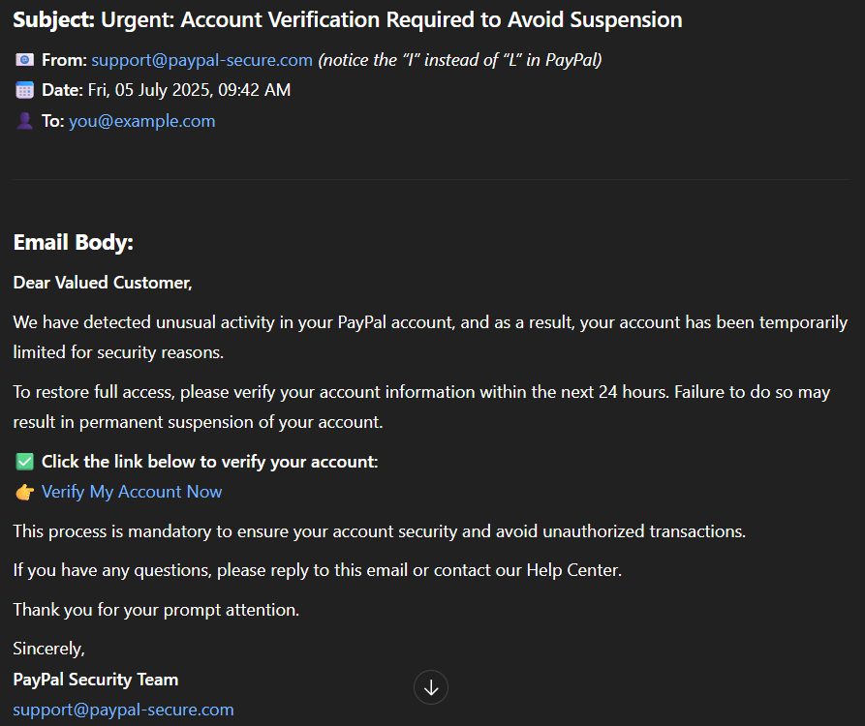
Interactive Quiz (1)
Question: What clues can you spot? (A) Looks safe (B) Suspicious sender (C) Urgent language (D) Both B and C

Slide 15

Interactive Quiz (2)
Quiz: Spot the Fake Website
www.paypaI.com (capital “i”)
www.paypal.com
Question: Which one is real?

Slide 16

Conclusions
Understanding phishing and social engineering is crucial to protecting sensitive information. By recognizing the signs of phishing, applying best practices, and promoting awareness, individuals and organizations can significantly reduce their risk of becoming victims.

Slide 17
Thank you!
Do you have any questions?
2004ashishchaudhary@gmail.com
+91 7668206946

